Slide 1

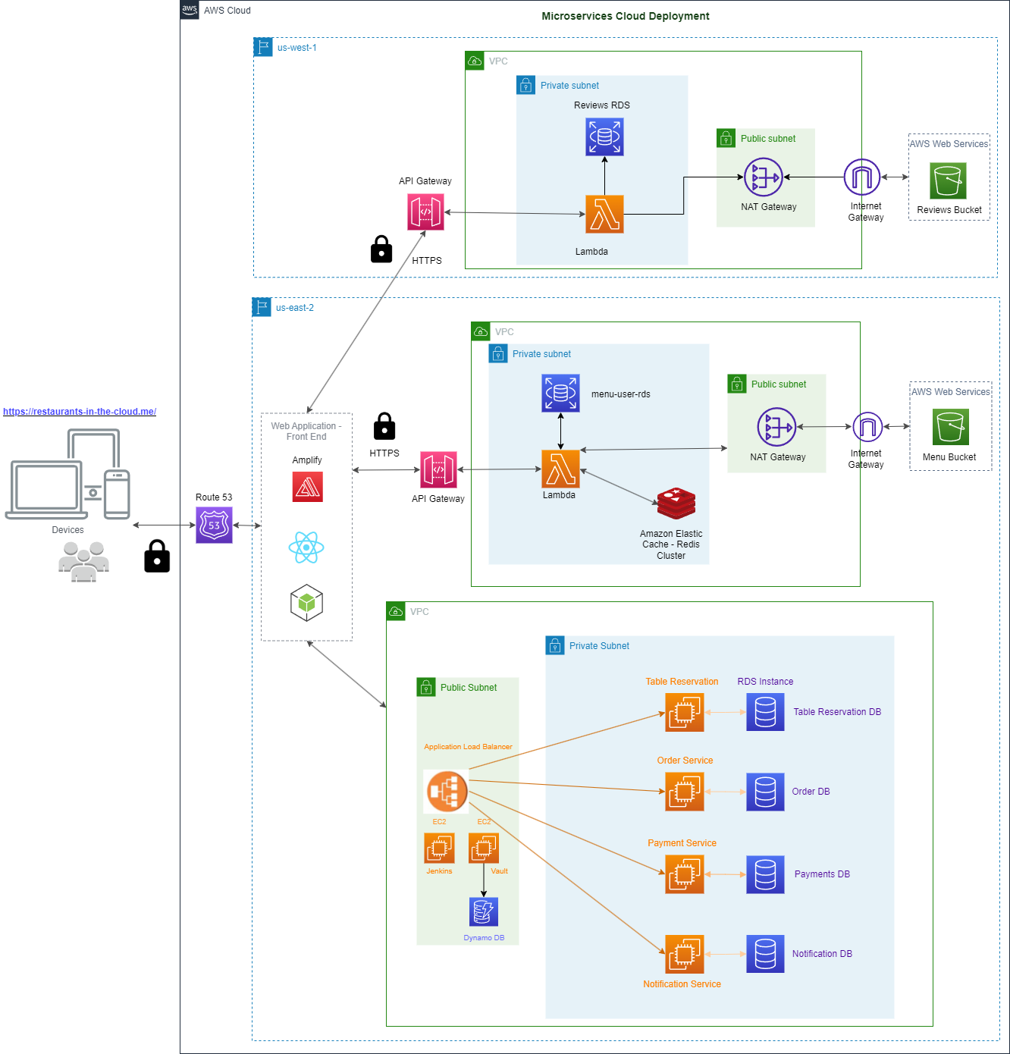
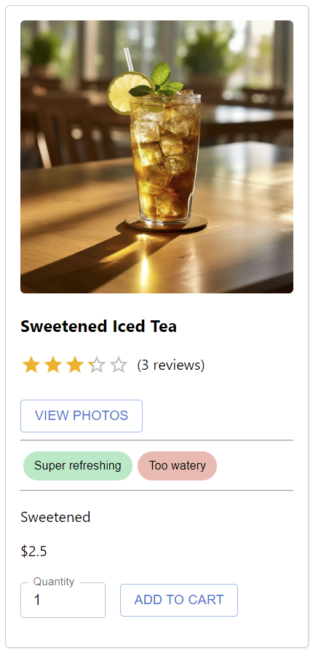
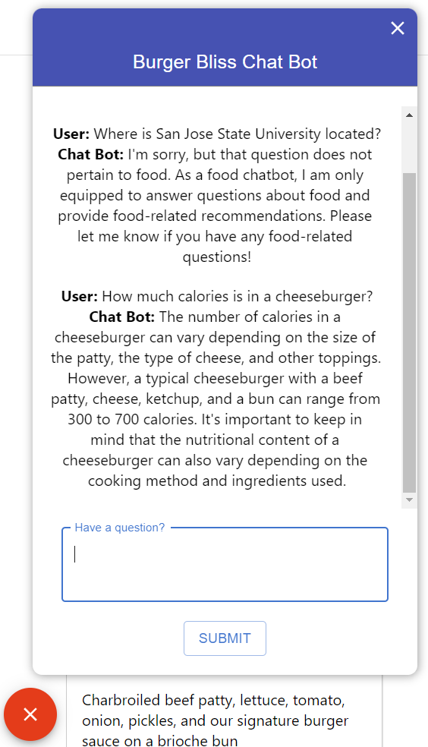
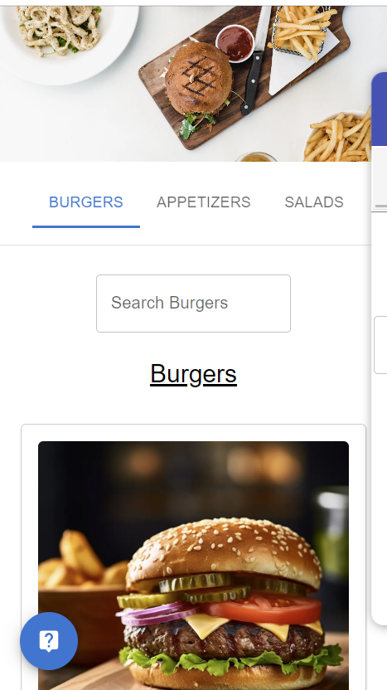
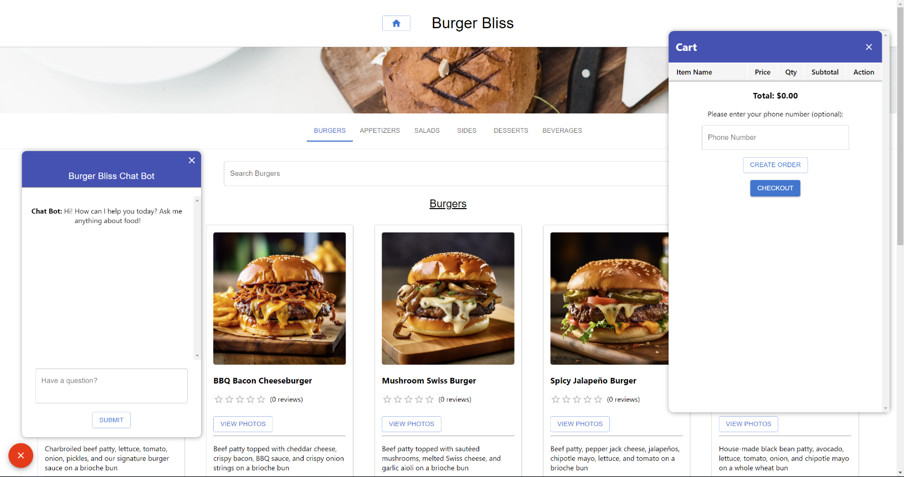
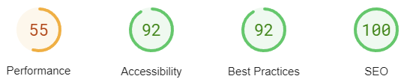
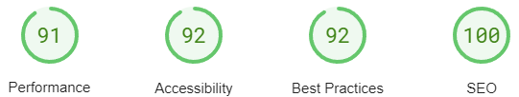
Computer Engineering Department
Cloud-Based Restaurant Management System
Project Advisor: Andrew Bond
Amrale, Netra (MS Software Engineering) Duong, Martin (MS Software Engineering)
Gupta, Mayuri (MS Software Engineering)
Patel, Ruchitkumar (MS Software Engineering)
Introduction
Methodology
Lambda, AWS RDS, AWS S3, and AWS ElasticCache for Redis. API gateway exposes the Lambda functions through a proxy. All Lambda functions, RDS and Redis Clusters are configured in same VPC, and the S3 Bucket is connected to the VPC using an Internet Gateway endpoint.
Summary/Conclusions
The restaurant industry is constantly evolving with innovative technologies to help better cater towards consumers’ preferences. The COVID-19 pandemic has played a significant role in shaping these consumer preferences. According to a survey by Bluedot, the pandemic has reduced the time a consumer is willing to wait for food from 10 minutes to 6 minutes. Currently there are many restaurant management solutions such as the Presto tablet, DoorDash, Uber Eats, OpenTable, and Toast, each with similar and varying functions. Consumers often must shuffle through multiple applications for food whether it be for dine-in, takeout, or delivery. 52% of consumers surveyed by the National Restaurant Association would like to see restaurants incorporate technology to make ordering and paying easier. Restaurants are often deterred from investing in these solutions for reasons such as cost of and ease of use, but to stay competitive, restaurants have no choice but to invest. According to research done by Toast, the average restaurant today offers five different ordering paths and seven different service models, with 74% of restaurants expected to increase their technology budget in 2023.
This project's purpose is to develop the foundations for an all-in-one restaurant management Software as a Service (SaaS) application backed by artificial intelligence to improve consumer experience and restaurant service quality. The application will utilize a microservice architectural style to ensure scalability and high availability. While the concept of the application is not novel, it seeks to address shortcomings of current solutions such as the need for multiple applications each with a different purpose. Additionally, a new challenge for the restaurant industry partly due to the COVID-19 pandemic is addressed: labor shortages. This application aims to serve as a good foundation for future expansion to further cater to the needs of not only restaurants, but any business, and most importantly, consumers.
Other cloud technologies used for deployment are:
Datadog (Cloud Monitoring as a Service)
Docker
HashiCorp
Vault
Terraform
Jenkins
Microservices Deployment Architecture Diagram
Due to ever-changing consumer preferences, this project proposed the development of an all-in-one restaurant management SaaS application to improve the overall consumer experience and restaurant service quality. By exploring the advantages and disadvantages of the many current solutions in the market, this project seeks to improve on those solutions. The application allows consumers to order food, reserve tables, waitlist, talk to a chat bot about food, write and view reviews, and upload photos. Verified reviews are summarized using artificial intelligence. Admins can create new restaurants with ease and oversee all operations. Managers can manage various aspects of their restaurant such as managing the menu, orders, and employees.
In conclusion, this application establishes a good foundation for further extension and research. Due to the restaurant management system being cloud-based, the hardware requirements for the application are very minimal for restaurants. The application is accessible and responsive for different platforms and devices allowing for both consumers and employees to utilize it anytime and anywhere.
Further Research
Integrate restaurant analytics with the chat bot to provide personalized suggestions
Cost analysis of this application in comparison to other solutions and devise pricing structure
Explore possible expansion into other business sectors such as grocery shopping
Optimize mobile version of application
Design
Key Features
Customer
Order / pay for food using Stripe
Reserve tables
View / write reviews and view / upload photos
Talk with a chat bot about food
Manager
Add, edit, and delete menu items and item categories and reviews
Add and manage employees
Admin
Same permissions as Manager
Create restaurants
Access to all restaurants
The figure on the left shows a menu item a summary of positive and negative points about the item. The figure on the right shows the AI chat bot responding to only food related inquires. Both are powered by the OpenAI API using GPT-3.5-Turbo.
The microservices based architecture includes both serverless and Docker based containers running on AWS EC2 instances. The React / Redux front-end is deployed on AWS Amplify. Hosted Zones are configured using Route 53. Route 53 redirects requests to AWS Amplify which will forward those requests to Application Load Balancers that accept HTTPS requests and finally those requests are forwarded to respective target groups based on path-based routing for the order, table reservation, and payment services. All EC2 instances are deployed in private subnets with Application Load Balancers in public subnets. The NAT Gateway is deployed in a private subnet to establish an outbound internet connection. Jenkins and HashiCorp Vault servers are deployed on EC2 instances which runs the CI/CD build and deploys pipelines from the web hooks designed on GitHub. Vault storage holds all of the security credentials for the application, databases, Stripe payments and Twilio keys.
The user management, menu management, and reviews microservices are deployed on a serverless framework. The serverless framework is configured using AWS
Key References
[1] Y. Liu, X. Huang, A. An and X. Yu, "Modeling and Predicting the Helpfulness of Online Reviews," 2008 Eighth IEEE International Conference on Data Mining, 2008, pp. 443-452, doi: 10.1109/ICDM.2008.94.
[2] A. Belarmino, C. Raab, J. Tang, and W. Han, “Exploring the motivations to use online meal delivery platforms: Before and during quarantine,” International Journal of Hospitality Management, vol. 96, Jul. 2021.
[3] A. Narang, “The Restaurant Industry Outlook Report 2023 Edition,” Toast, https://d2c9w5yn32a2ju.cloudfront.net/assets/Toast-Restaurant-Industry-Outlook-Report-2023-Edition.pdf.
[4] O. Al-Debagy and P. Martinek, "A Comparative Review of Microservices and Monolithic Architectures," 2018 IEEE 18th International Symposium on Computational Intelligence and Informatics (CINTI), 2018, pp. 000149-000154, doi: 10.1109/CINTI.2018.8928192.
Methodology
Cloud Deployment Technologies
Most of the cloud technologies used for deployment were provided by Amazon Web Services (AWS):
Amplify
API Gateway
CloudWatch
ElastiCache for Redis
Elastic Compute Cloud (EC2)
Elastic Container Registry
Identity and Access Management (IAM)
Lambda
Relational Database Service (RDS)
Route 53 (R53)
S3
Virtual Private Cloud (VPC)
The figures above show the menu page views on a mobile device and a desktop. The application is responsive to all devices. The mobile view is specifically on an iPhone SE with a resolution of 375 x 667, while the desktop view is on a monitor with a resolution of 2560 x 1440.
Performance testing of menu page using Google PageSpeed, mobile slightly struggles due to the excessive DOM size.
Performance Testing
Acknowledgements
Mobile
The authors are deeply indebted to Professor Andrew Bond for his invaluable comments and assistance in the preparation of this project.
Desktop

